Slide 1
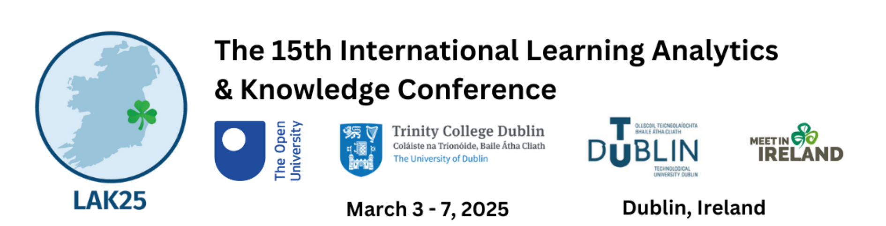

Advancing privacy in learning analytics using differential privacy
6th March, 2025

Slide 2




Team Introduction
We are based in Centre for the Science of Learning & Technology (SLATE), University of Bergen, Norway
Faculty of Organisational Sciences, University of Belgrade

Slide 3
Agenda
Background and motivation
Basic of differential privacy
DEFLA (differential privacy framework for learning analytics)
Validated DELFA framework in expeirments
Discussion
Conclusion and future work

Slide 4
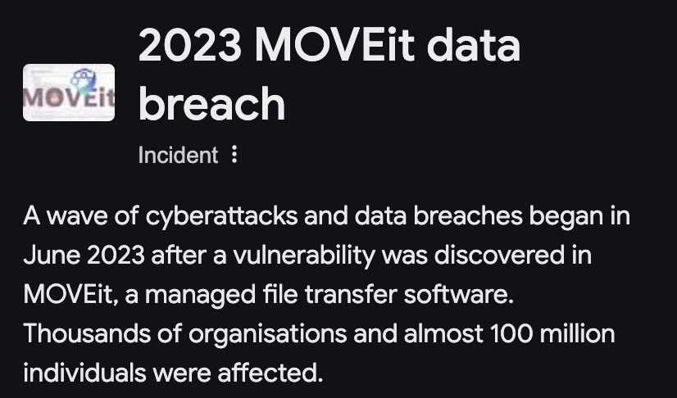
Background 1
Data collected about learners and learning processes is a cornerstone for advancing learning analytics (LA) research and practice.
However, collecting and analysing such data is prone to serious data privacy violations

Slide 5

Background 2
Stricter legal regulations are being introduced worldwide, such as the GDPR, Data Governance Act, and California Privacy Rights Act (CPRA)
As privacy protection has become a legal requirement and social consensus, if not appropriately handled, it may prevent LA from reaching its full expected potential

Slide 6

Background 3 - Differential privacy
Previous methods such as k-anonymity, l-diversity, m-invariance, and t-closeness have been jailbroken
Differential privacy (DP) is an advanced privacy-preserving technique that can handle the current challenge in the age of AI
It can also defend against many other attacks on sensitive data, such as bias attacks, composition attacks
DP can scale to large datasets and complex queries
DP has become a widely used privacy protection approach in statistical data analysis and machine learning over the past decade

Slide 7

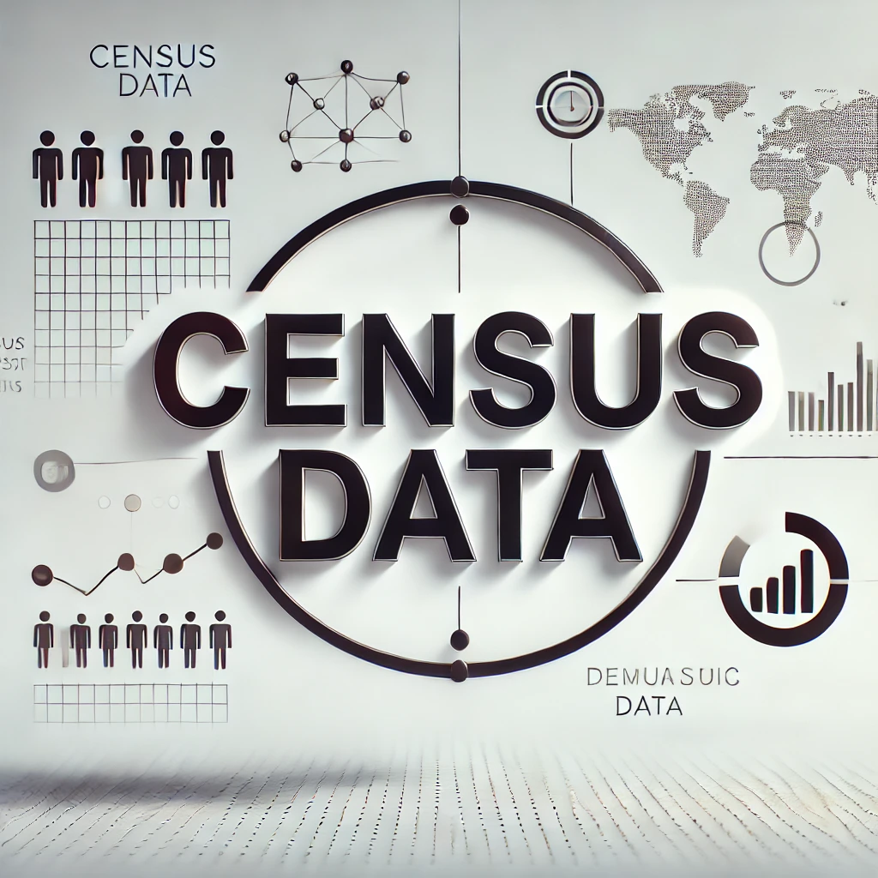

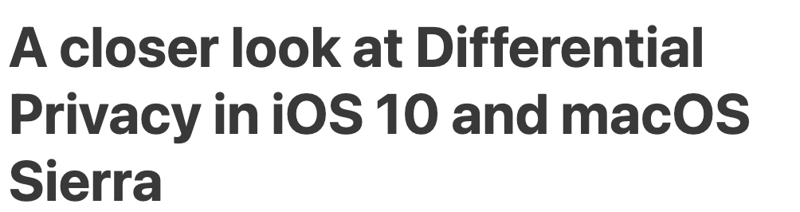
Background 3- Differential privacy 2
DP has become a widely used privacy protection approach in statistical data analysis and machine learning over the past decade
DP has been applied to many fields:
Major company has stepped in:
Apple: Differential Privacy in iOS and macOS since 2016
Google:
Medical
IoT
Census

Slide 8

Motivation and Contribution
Inspired by the advantages of DP and many privacy measures in LA is lack of practical guidance, with limited practical application evidence
We made the following contributions:
Introduction of the first DP framework for education and learning analytics to guide practitioner to use this technique
Proof-of-concept, validate in experiment
Privacy-utility trade-off analysis
Notes:
Introduction of the first DP framework for education and learning analytics: We propose the first framework
for applying Differential Privacy (DP) to the educational sector, providing practitioners with guidance on
implementing DP in LA contexts. • Proof-of-concept: We empirically demonstrate the feasibility of our framework using a well-known LA dataset.
• Privacy-utility trade-off analysis: Our work includes a comprehensive analysis of the results and showcases how
different DP configurations impact both the privacy guarantees and the utility of the data for LA tasks.

Slide 9

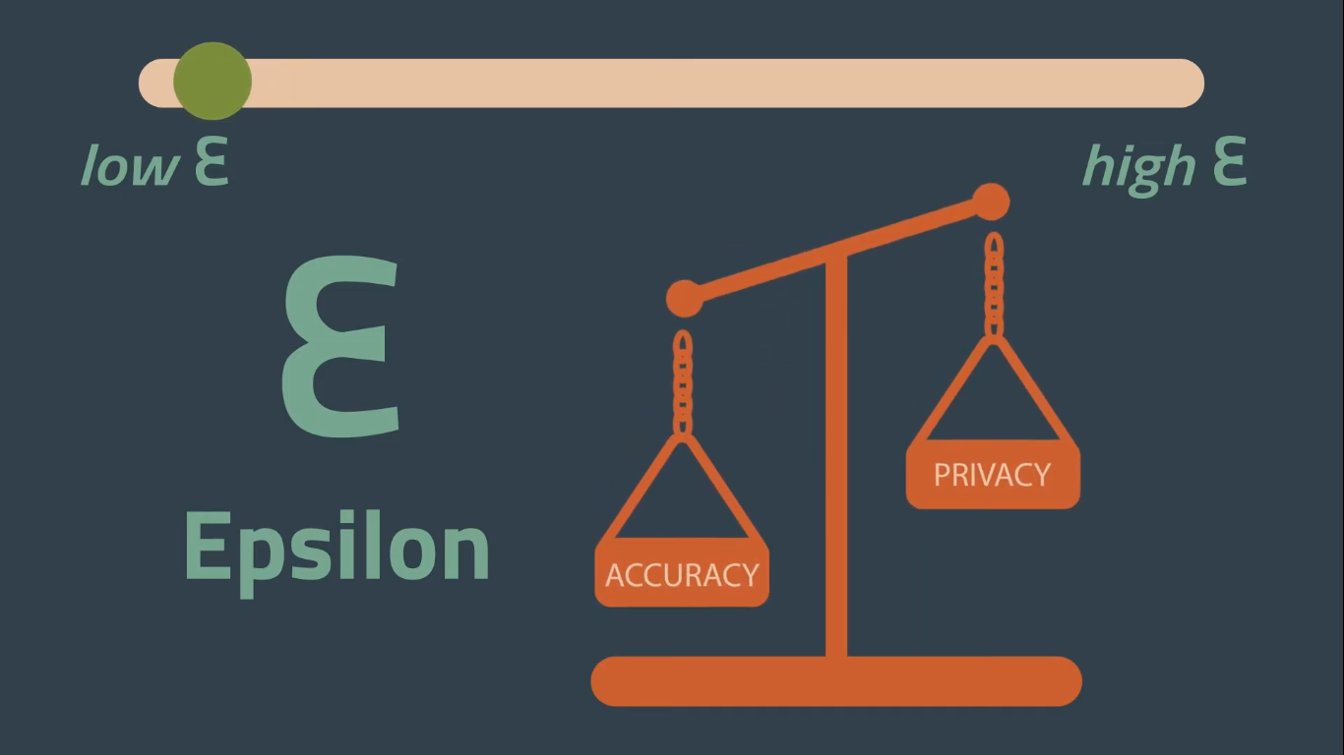
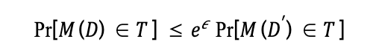
Basics of differential privacy
 | Age | With differential privacy adding noise
 | 20 | 20
 | 30 | 30
 | 40 | 40
Average | 30 | 30
Remove one record, the computation results would be the same! Very cool!
The amount of noise is control by epsilon
Definition of differential privacy

Slide 10
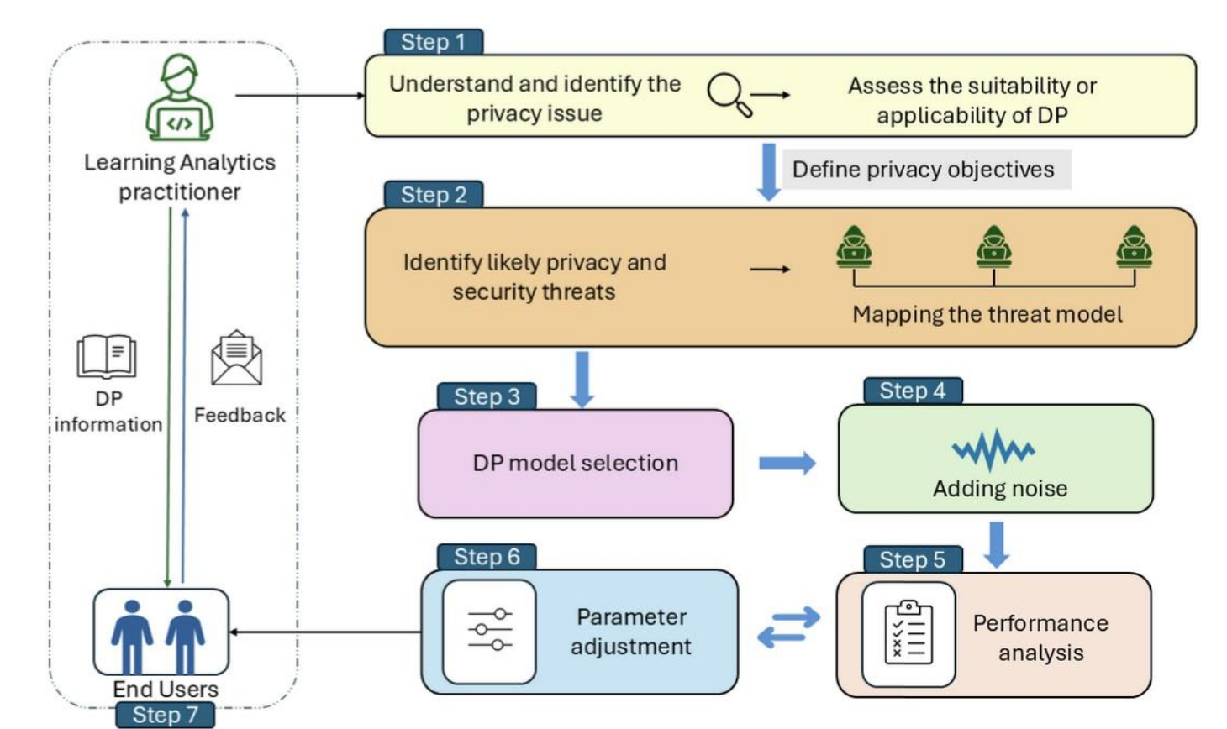
DEFLA (Differential privacy framework for learning analytics)

Slide 11
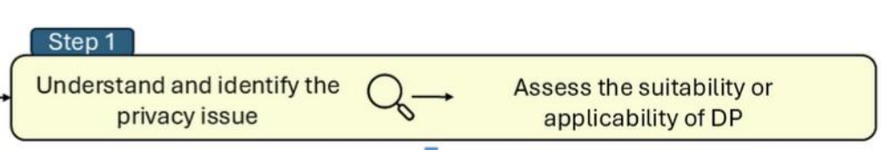
DEFLA (Step 1)
many types of privacy issues that may arise in a LA process, some of these problems are not suitable for DP
DP is suitable when data of high volume and complexity, sharing data with privacy requirements, and training a wide range of machine learning model
Unsuitable for smaller data scales, scenarios with high demand for precise analysis, scenarios without high privacy requirements, and scenarios requiring real-time data analysis or rapid response time

Slide 12
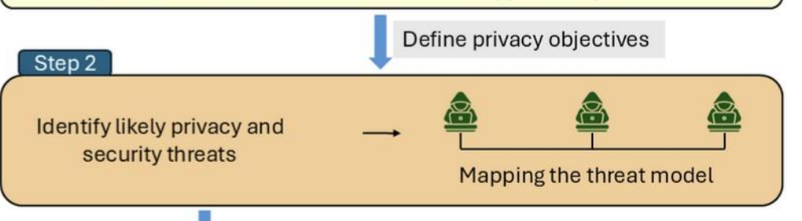
DEFLA (Step 2)
Build a threat model.
Threat modelling identifies potential threats and develops countermeasures by answering questions such as
“Where am I most vulnerable to attack?”, “What are the most relevant threats?”
“What do I need to do to defend against these threats?”
3. many commonly used threat modelling frameworks available for practitioners, such as the
STRIDE framework developed by Microsoft and the seven-step PASTA threat analysis process

Slide 13
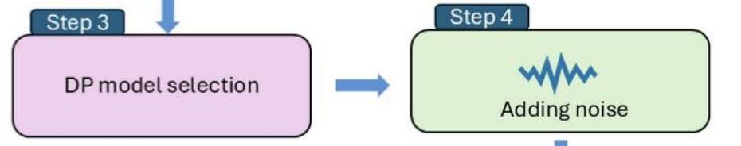
DEFLA (Step 3 & 4)
Step 3: 1) adding noise at which step 2) noise mechanism 3) interactive approach or non-interactive .
Threat modelling identifies potential threats and develops countermeasures by answering questions such as
“Where am I most vulnerable to attack?”, “What are the most relevant threats?”
“What do I need to do to defend against these threats?”
3. many commonly used threat modelling frameworks available for practitioners, such as the
STRIDE framework developed by Microsoft and the seven-step PASTA threat analysis process

Slide 14
DEFLA (Step 5 & 6)
Step 3: 1) adding noise at which step 2) noise mechanism 3) interactive approach or non-interactive .
Threat modelling identifies potential threats and develops countermeasures by answering questions such as
“Where am I most vulnerable to attack?”, “What are the most relevant threats?”
“What do I need to do to defend against these threats?”
3. many commonly used threat modelling frameworks available for practitioners, such as the
STRIDE framework developed by Microsoft and the seven-step PASTA threat analysis process

Slide 15
DEFLA (Step 2)

Slide 16

Thank you for listening!
Question?
Contact me: qinyi.liu@uib.no
Link to the paper

